Slide 1
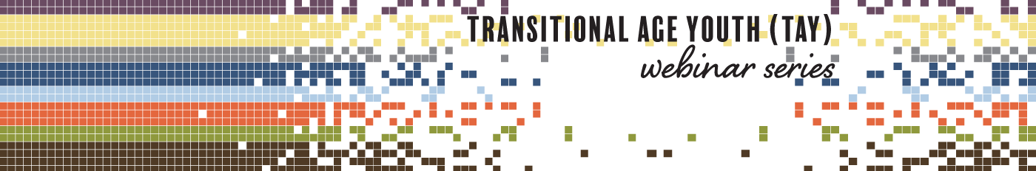



Who? What? Where? Why?
Clinical Sites for TAY Addiction Treatment
Produced in Partnership by:

Slide 2





Produced in Partnership…
attcnetwork.org
amersa.org
sbirt.webs.com
Notes:
This webinar is produced in partnership with the ATTC Network Coordinating Office, AMERSA, and the Adolescent SBIRT Project by NORC at the University of Chicago.

Slide 3
The Impact of Substance Use on the Developing Adolescent Brain
Who's Doing What?: The Epidemiology of Adolescent Substance Use
Substance Use Interventions for Adolescents and Transitional Age Youth
Integrating Stigmatized Loss and Disenfranchised Grief into the SBIRT Model
amersa.org/resources/tay-webinar-series
Notes:
This webinar is a part of the Transitional Age Youth Webinar Series. Sign up for these other titles.

Slide 4
Substance Use in Adolescents and Transitional Age Youth: Justice Involvement and Homelessness
Digital Mental Health and Addiction Interventions for Adolescents, Young Adults and Families
Substance Use Disorders: Appreciating the Challenges of Minority Youth
Who? What? Where? Why? Clinical Sites for TAY Addiction Treatment
amersa.org/resources/tay-webinar-series
Notes:
This webinar is a part of the Transitional Age Youth Webinar Series. Sign up for these other titles.

Slide 5




Webinar Presenters
Veronika Mesheriakova, MD
Assistant Professor of Pediatrics and Adolescent Medicine, UCSF; Director of UCSF Youth Outpatient Substance Use Program (YoSUP)
Shannon Mountain-Ray, MSW, LICSW
Director of Integrated Care, Adolescent Substance Use and Addiction Program’s Primary Care Program (ASAP-PC), Boston Children’s Hospital
Andrea Dickerson, LMFT, IADC
Director of Behavioral Health – YSS
Notes:
Today’s webinar presenters are Dr. Veronika Mesheriakova, Shannon Mountain-Ray and Andrea Dickerson.

Slide 6
Disclosures
Today’s presenters have no conflicts of interest to disclose.

Slide 7
Objectives
After completing this activity, learners will be able to:
Describe why early addiction treatment is important
Outline unique aspects of TAY addiction treatment
Describe ASAM levels of care and placement criteria for TAY
Name evidence-based practices that can be used in each level of care

Slide 8
Substance Use and Addiction as a Pediatric Priority
Adolescence is a neurobiologically vulnerable time period for the development of substance use disorders
Fully developed pain and reward pathways
Immature prefrontal cortex
Dennis 2002
Notes:
Dennis, M.; Babor, T.F.; Roebuck, C.; and Donaldson, J. Changing the focus: The case for recognizing and treating cannabis use disorders. Addiction 97:(s1):4–15, 2002.

Slide 9
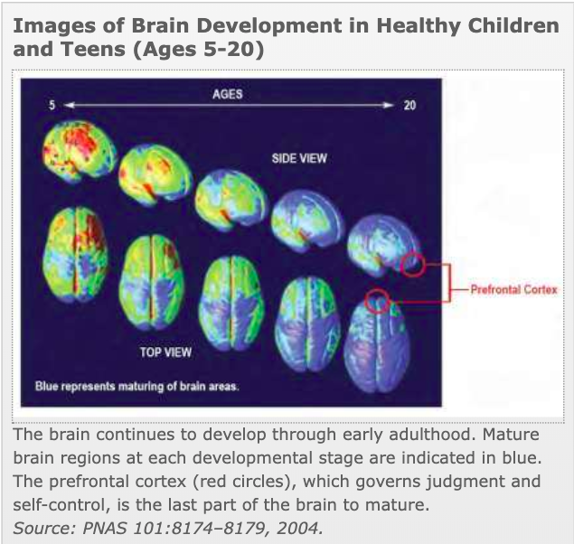
Substance Use and Addiction as a Pediatric Priority
Dennis 2002
Notes:
And we know that the prefrontal cortex, the area of the brain that is associated with judgement, self control, and future planning is the last area to develop.
This is often really hard to grasp. When we interact with adolescents, many can appear to be quite adult-like in their development. They can do complex math, they have a strong grasp of language, they can formulate fairly intelligent arguments; so it is easy to assume that they should “know better” or make better choices.
However we have to remind ourselves that adolescent brains remain fundamentally different in really important ways.
For example, brain size is about 90% of adult size by age 6! However, changes in grey matter (neurons) and white matter (myelin) continue throughout adolescence as neurons are “pruned” and neural pathways are strengthened. This is incredibly important in the field of adolescent addiction because neural pathways that get used most often are the ones that get strengthened through a process called kindling. The kindling phenomenon is best described using seizures as an example. We know that the more frequently someone experiences a seizure, the more likely they are to experience subsequent seizures, and over time, it actually takes less of a stimulus to trigger a seizure. This is because that seizure pathway becomes like a well-worn path - a path of least resistance.
The same can be said of addiction. The more frequently an adolescent activates the dopamine reward pathway with drugs, the more “worn in” those neural pathways become and over time, addiction can get “baked in” to the developing brain.
So adolescent brains are a bit like fancy sports cars with malfunctioning brakes. They are made for speed and excitement and novelty but they have trouble slowing down when it is most important.
This is why it is so important to detect and address substance use early!
Dennis, M.; Babor, T.F.; Roebuck, C.; and Donaldson, J. Changing the focus: The case for recognizing and treating cannabis use disorders. Addiction 97:(s1):4–15, 2002.

Slide 10
Substance Use and Addiction as a Pediatric Priority
Adolescents are the group that is most likely to experience health consequences related to substance use
Accidents
Dating violence
Risky sexual practices
Development of substance use disorders
Vagi 2015; Ritchwood 2015; Monahan 2014; Nelson 2015; Levy 2016
Notes:
Most likely to experience health consequences – from MMWR surveillance summary 2013
Studies have shown that adolescents who regularly abuse substances are more likely to initiate sex at a younger age, to have more sex partners, to have unprotected sex, and to become infected with an STI (other citations form Ritchwood paper)

Slide 11
Addiction Usually Starts in Adolescence
90% adults who suffer from a substance use disorder started using substances before age 18 and developed their substance use disorder before age 20
Younger age at first substance use is a strong risk factor for the development of substance use disorders:
  First drink before age 14 = 15.4% will develop a use disorder
  First drink after age 21 = 2.1% will develop a use disorder
  First misuse of Rx drugs before age 13 = 25% will develop a use disorder
Dennis 2002; McCabe 2017
Notes:
50% of adults who suffer from SUD started using substances before age 15
Dennis, M.; Babor, T.F.; Roebuck, C.; and Donaldson, J. Changing the focus: The case for recognizing and treating cannabis use disorders. Addiction 97:(s1):4–15, 2002.
McCabe, S.E.; West, B.T.; Morales, M.; Cranford, J.A.; and Boyd, C.J. Does early onset of non-medical use of prescription drugs predict subsequent prescription drug abuse and dependence? Results from a national study. Addiction 102(12):1920–1930, 2007.

Slide 12
Earlier Substance Use Impacts Duration of Illness
Predictors of disease duration
Age of first use impacts disease duration:
  Started using before age 15 🡪 disease duration of 29 years
  Started using after age 20 🡪 disease duration of 18 years
Timing of treatment impacts disease duration:
  Treatment with in 20 years of first use 🡪 disease duration of 35+ years
  Treatment within 10 years of first use 🡪 disease duration of 15 years
Dennis 2007
Notes:
Dennis, M., & Scott, C. K. (2007). Managing addiction as a chronic condition. Addiction Science & Clinical Practice, 4(1), 45.

Slide 13
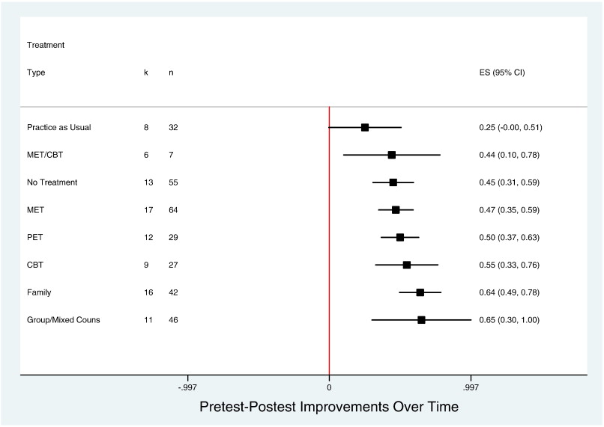
Early Addiction Treatment is Effective
Tanner-Smith 2013
Notes:
And we also know that early addiction treatment is effective in reducing adolescent substance use
A meta-analysis of outpatient psychosocial treatment modalities by Tanner-Smith et al revealed that most treatment types are effective in reducing adolescent substance use (lower frequency of use, more abstinence)
PET – psychoeducational therapy
Fig. 1. Comparisons between different treatment types. Notes: The arrows point to the treatment type with the more positive outcomes in each comparison. The thickness of each arrow indicates the magnitude of the mean effect size and the number of studies on which it is based, each equally weighted. The treatment types are arrayed from left to right with those to the right generally showing larger positive effects than those to the left with which they are compared.
Tanner-Smith, E. E., Wilson, S. J., & Lipsey, M. W. (2013). The comparative effectiveness of outpatient treatment for adolescent substance abuse: A meta-analysis. Journal of substance abuse treatment, 44(2), 145-158.: https://reader.elsevier.com/reader/sd/pii/S0740547212001055?token=ED01A398B7F9AAF267D482D923988F219AA4495CDBC5E3576197002FF07856064A26F91E20E82E5519E707ADDA579240

Slide 14
TAY Addiction Treatment Availability
Between 2003 and 2010, less than 36% of addiction treatment programs in the U.S. offered services to adolescents
The number of programs offering services to adolescents declined during that time period (29% of programs in 2010)
Adult addiction treatment programs often don’t take into account the unique needs of adolescents and young adults
Services offered at addiction treatment programs are often inconsistent and not necessarily evidence-based
Mericle, 2015
Notes:
But even when addiction is recognized, few programs offer services that are tailored to the unique needs of youth.
Mericle, A. A., Arria, A. M., Meyers, K., Cacciola, J., Winters, K. C., & Kirby, K. (2015). National trends in adolescent substance use disorders and treatment availability: 2003–2010. Journal of child & adolescent substance abuse, 24(5), 255-263.

Slide 15
General Treatment Principles for TAY
Most youth with SUD will benefit from a combination of medical AND psychosocial interventions
The level of care should be chosen based on an individual patient and family assessment and should be the least restrictive possible
FDA-approved medications for nicotine, alcohol, and opioid use disorders are available for adults. These may be used “off label” for adolescents
Notes:
Intro: So what types of treatments can we offer to youth with substance use disorders once we identify them?

Slide 16
Unique Aspects of TAY Addiction Treatment
Treatment Should be Developmentally Appropriate
Early Adolescence (ages 10-13)
Rapid physical changes (puberty)
Concrete thinking, preoccupation with self, impulsive behavior
Beginning of transition from family group to peer group
Beginning of identity development (testing authority, developing own value system)
Middle Adolescence (ages 14-16)
Development of abstract thinking and future planning
Further separation from family and engagement with peer group “subculture”
Increased ability to empathize with others
Increased sensitivity to peer social stimuli (increased risk-taking behavior)
Late Adolescence (Ages 17-21)
Further development of abstract thinking and future planning (less focus on self-centered concepts, better able to weigh pros/cons)
Development of personal identity
Better ability to delay gratification
Peer group values may become less influential
.
Neinstein 2016
Notes:
Neinstein, L. S. (Ed.). (2016). Adolescent health care: a practical guide (Sixth Edition). Lippincott Williams & Wilkins.

Slide 17
Unique Aspects of TAY Addiction Treatment
Low Internal Motivation for Treatment
Less likely to recognize substance use as problematic
Not ready to stop using substance(s)
More likely to see the positive aspects of substance use vs. negative
Low Rates of Treatment Retention
Rates of treatment retention may vary by race/ethnicity
Adolescents with trauma history may discontinue treatment sooner
Retention may be affected by type of substances used
Treatment retention is improved with pharmacologic treatment of OUD
.
Becan 2015; Titus 2006, Wu 2011; Campbell 2006; Jaycox 2004; Battjes 2004; Hadland 2018
Notes:
Treatment Retention per Campbell et al - Native American adolescents less likely to return after intake compared to white peers; African American adolescents spend less time in treatment than white peers.
Retention by substance per Battjes et al - less likely to remain in treatment if using alcohol or cannabis only (vs other drugs)
Becan, J. E., Knight, D. K., Crawley, R. D., Joe, G. W., & Flynn, P. M. (2015). Effectiveness of the Treatment Readiness and Induction Program for increasing adolescent motivation for change. Journal of substance abuse treatment, 50, 38-49.
Titus, J. C., & Dennis, M. L. (2006). Cannabis youth treatment intervention: Preliminary findings and implications. Adolescent substance abuse: Research and clinical advances, 104-126.
Wu, L. T., Blazer, D. G., Li, T. K., & Woody, G. E. (2011). Treatment use and barriers among adolescents with prescription opioid use disorders. Addictive behaviors, 36(12), 1233-1239.
Campbell, C. I., Weisner, C., & Sterling, S. (2006). Adolescents entering chemical dependency treatment in private managed care: ethnic differences in treatment initiation and retention. Journal of Adolescent Health, 38(4), 343-350.
Jaycox, L. H., Ebener, P., Damesek, L., & Becker, K. (2004). Trauma exposure and retention in adolescent substance abuse treatment. Journal of Traumatic Stress: Official Publication of The International Society for Traumatic Stress Studies, 17(2), 113-121.
Battjes, R. J., Gordon, M. S., O'Grady, K. E., & Kinlock, T. W. (2004). Predicting retention of adolescents in substance abuse treatment. Addictive Behaviors, 29(5), 1021-1027.
Hadland, S. E., Bagley, S. M., Rodean, J., Silverstein, M., Levy, S., Larochelle, M. R., ... & Zima, B. T. (2018). Receipt of timely addiction treatment and association of early medication treatment with retention in care among youths with opioid use disorder. JAMA pediatrics, 172(11), 1029-1037.

Slide 18

Unique Aspects of TAY Addiction Treatment
Family Engagement is Key
Reduction of parent-child conflict
Improved caregiver mental health
Improved rates of treatment adherence and completion
Longer duration of abstinence from substance use
Fewer relapses
.
Kumpfer 2003; Liddle 2004; Steinglass 2009; Copello 2005; Smith 2004

Slide 19
The Spectrum of Addiction Treatment
.

Slide 20
ASAM Levels of Care
0.5 - Early Intervention
1 - Outpatient Services
2 - Intensive Outpatient/Partial Hospitalization Services
  2.1 – Intensive Outpatient Services
  2.5 – Partial Hospitalization Services
3 - Residential/Inpatient Services
  3.1 – Clinically Managed Low-Intensity Residential Services
  *3.3 – Clinically Managed Population-Specific High-Intensity Residential Services
  3.5 – Clinically Managed Medium-Intensity Residential Services
  3.7 – Medically Monitored High-Intensity Inpatient Services
4 - Medically Managed Intensive Inpatient Services
* Not designated for adolescents

Slide 21
0.5 - Early Intervention
Assessment and Education services for those who:
  May be at identifiable risk of developing substance-related problems
  There is not yet sufficient information to document a diagnosable substance use disorder
Mee-Lee, D. (2013)
The ASAM Criteria, ASAM Continuum https://www.asamcontinuum.org/knowledgebase/what-are-the-asam-levels-of-care/

Slide 22
1 - Outpatient Services
Least restrictive level of outpatient care
Typically consists of less than: 9 hours of service/week for adults, or less than 6 hours a week for adolescents for recovery or motivational enhancement therapies and strategies
May be delivered in a wide variety of settings
Mee-Lee, D. (2013)
The ASAM Criteria, ASAM Continuum https://www.asamcontinuum.org/knowledgebase/what-are-the-asam-levels-of-care/

Slide 23
2.1 - Intensive Outpatient Programs (IOP)
Organized outpatient service that delivers treatment services during the day, before or after work or school, in the evening, and/or on weekends
Typically consists of 9 or more hours of service a week or 6 or more hours for adults and adolescents respectively to provide support and stabilization for a range of needs
Capable of meeting the complex needs of people with substance use disorders and co-occurring conditions
http://bpd.about.com/od/levelsofcare/g/IOP.htm
Mee-Lee, D. (2013)
The ASAM Criteria, ASAM Continuum https://www.asamcontinuum.org/knowledgebase/what-are-the-asam-levels-of-care/

Slide 24
2.5 - Partial Hospitalization Programs (PHP)
Most intensive level of outpatient care
Can be utilized as increased support from outpatient level of care or as a step down from inpatient/residential care to outpatient
Organized outpatient service that delivers treatment services usually during the day as day treatment or partial hospitalization services
Typically provides 20 or more hours of service a week for multidimensional instability that does not require 24-hour care
Capable of meeting the complex needs of people with substance use disorders and co-occurring conditions
http://www.cignabehavioral.com/web/basicsite/provider/pdf/levelOfCareGuidelines.pdf
Mee-Lee, D. (2013)
The ASAM Criteria, ASAM Continuum https://www.asamcontinuum.org/knowledgebase/what-are-the-asam-levels-of-care/

Slide 25
3.1 – Clinically Managed Low-Intensity Residential Services
Typically provides a 24 hour living support and structure with available trained personnel
Offers at least 5 hours of clinical service a week
Mee-Lee, D. (2013)
The ASAM Criteria, ASAM Continuum https://www.asamcontinuum.org/knowledgebase/what-are-the-asam-levels-of-care/

Slide 26
*3.3 – Clinically Managed Population-Specific High-Intensity Residential Services
Adult only level of care
Typically offers 24-hour care with trained counselors
Stabilization and treatment for those with cognitive or other impairments unable to use full active milieu or therapeutic community
Mee-Lee, D. (2013)
The ASAM Criteria, ASAM Continuum https://www.asamcontinuum.org/knowledgebase/what-are-the-asam-levels-of-care/

Slide 27
3.5 – Clinically Managed Medium-Intensity Residential Services
Provides 24-hour care with trained counselors to stabilize multidimensional imminent danger and prepare for outpatient treatment
Patients in this level are able to tolerate and use full active milieu or therapeutic communities
Mee-Lee, D. (2013)
The ASAM Criteria, ASAM Continuum https://www.asamcontinuum.org/knowledgebase/what-are-the-asam-levels-of-care/
Notes:
Called Clinically Managed Medium-Intensity Residential Services for adolescents and Clinically Managed High-Intensity Residential Services for adults

Slide 28
3.7 – Medically Monitored High-Intensity Inpatient Services
Provides 24-hour nursing care with a physician’s availability
Patients in this level of care require medication and have a recent history of withdrawal management at a less intensive level of care
Appropriate setting for patients with “subacute biomedical and emotional, behavioral, or cognitive problems that are so severe that they require inpatient treatment”
Mee-Lee, D. (2013)
The ASAM Criteria, ASAM Continuum https://www.asamcontinuum.org/knowledgebase/what-are-the-asam-levels-of-care/
Notes:
Called the Medically Monitored High-Intensity Inpatient Services for adolescents and Medically Monitored Intensive Inpatient Services Withdrawal Management for adults

Slide 29
4 - Medically Managed Intensive Inpatient Services
Offers 24-hour nursing care and daily physician care for severe, unstable problems in ASAM Dimensions 1, 2 or 3
Counseling is available 16 hours a day to engage patients in treatment
Stabilization with plan to continue care post discharge
Mee-Lee, D. (2013)
The ASAM Criteria, ASAM Continuum https://www.asamcontinuum.org/knowledgebase/what-are-the-asam-levels-of-care/

Slide 30
Treatment Matching

Slide 31
ASAM Dimensions
Dimension 1 - Acute Intoxication and/or Withdrawal Potential
  Include past and current substance use and withdrawal symptoms
Dimension 2 - Biomedical Conditions and Complications (medication, recent illnesses, medication compliance)
  Include current medication and purpose, last visit to a medical professional, any ways medication/physical health is impacting treatment
Dimension 3 – Emotional, Behavioral, or Cognitive Conditions and Complications
  Include the individual’s mental health issues and symptoms present, participation in the program, any behavioral issues
Dimension 4 – Readiness to change
  Identify the individual’s motivation to change, level of ambivalence, stage of change
Dimension 5 – Relapse, Continued Use, or Continued Problem Potential
  Include the individual’s current use, history of relapse, triggers identified and coping skills to those triggers
Dimension 6 – Recovery/Living Environment
  Include the individual’s current living arrangement, support system, family involvement, recent family sessions and topics discussed, involvement in 12 Steps, including if the individual has a sponsor and utilizing the sponsor
Mee-Lee, D. (2013)
Notes:
Mee-Lee, D., Shulman, G. D., Fishman, M. J., Gastfriend, D. R., Miller, M. M., & Provence, S. M. (2013) The ASAM Criteria: Treatment Criteria for Addictive, Substance-Related, and Co-Occurring Conditions.

Slide 32
ASAM Dimensions
Each dimension is rated 0-4
  0 – none/routine/optimal function
  1 – distressing/above average functioning
  2 – debilitating/complex/average functioning
  3 – incapacitating/urgent/below average functioning
  4 – imminent danger/emergency/difficult functioning
Using ASAM to guide treatment allows for a more personalized, individualized experience
The ratings of each dimension are used to determine the correct level of care, need for continued care, and when transfer/discharge is appropriate
The Dimension with the highest rating alerts the provider on where to focus treatment
Frequency of ASAM assessment
Outpatient (Level 1) - minimum of monthly
Intensive Outpatient (Level 2.1) and higher - minimum of weekly
Mee-Lee, D. (2013)
Notes:
Mee-Lee, D., Shulman, G. D., Fishman, M. J., Gastfriend, D. R., Miller, M. M., & Provence, S. M. (2013) The ASAM Criteria: Treatment Criteria for Addictive, Substance-Related, and Co-Occurring Conditions.

Slide 33
ASAM Treatment Matching Matrix
Outpatient Level 1
  Dimension 1 - Acute Intoxication and/or Withdrawal Potential
    Rating 0 - no withdrawal risk
  Dimension 2 - Biomedical Conditions and Complications (medication, recent illnesses, medication compliance)
    Rating 0 or 1 - no concerns or able to be managed in an outpatient environment
  Dimension 3 – Emotional, Behavioral, or Cognitive Conditions and Complications
    Rating 0 or 1 - no risk or low risk of harm; minimal to mild interruption with daily living
  Dimension 4 – Readiness to change
    Rating 0 or 1 - willing to engage and explore substance use
  Dimension 5 – Relapse, Continued Use, or Continued Problem Potential
    Rating 0 or 1 - able to control use, maintain abstinence
  Dimension 6 – Recovery/Living Environment
    Rating 0 or 1 - active support system
When a Dimension has a higher rating, it could indicate a need for a higher level of care especially if Dimension 1 or 2
Mee-Lee, D. (2013)
Notes:
Mee-Lee, D., Shulman, G. D., Fishman, M. J., Gastfriend, D. R., Miller, M. M., & Provence, S. M. (2013) The ASAM Criteria: Treatment Criteria for Addictive, Substance-Related, and Co-Occurring Conditions.

Slide 34
ASAM Treatment Matching Matrix
Jacob is a 17 year old who got caught drinking alcohol at a party and charged with minor in possession. His mom referred him for a substance use evaluation because she is concerned. His grades have started to decline and he is starting to hang out with friends she does not know. Jacob and his father have a tense relationship and minimal contact at this point.
Dimension 1 – Acute Intoxication/Withdrawal Potential (0): Although Jacob reports being under the influence at the time of the arrest, he is not at this time. He denies any withdrawal symptoms and the quantity and frequency of his substance use support this.
Dimension 2 – Biomedical Conditions/Complications (0): Jacob is not on any medications and does not report any physical health concerns.
Dimension 3 – Emotional/Behavioral/Cognitive Conditions and Complications (1): Jacob’s recent struggles in school and recent legal charge are concerning. He appears embarrassed about his grades since he may not graduate on time. It appears his behaviors changed a few months ago and have quickly deteriorated.
Dimension 4 – Readiness to Change (1): Jacob appears cooperative and in Contemplation stage of change. He seems to want to change his behaviors in order to get back on track with school and graduate. He seems to be considering the negative impact of his substance use.
Dimension 5 – Relapse/Continued Use/Continued Problem Potential (1): Jacob is at moderate risk of relapse due to his current peer group, who all use substances, and his lack of awareness/education of his triggers and warning signs.
Dimension 6 – Recovery/Living Environment (1): Jacob lives with his mother and she seems supportive. Jacob has a conflictual relationship with his father and they have not talked other than his dad yelling at him the night Jacob was charged. Jacob’s peer group use substances and he could benefit from developing a healthy support system of peers that don’t use substances.
Recommended Level of Care - Outpatient Level 1 - one or two individual therapy sessions a week
Mee-Lee, D. (2013)
Notes:
Mee-Lee, D., Shulman, G. D., Fishman, M. J., Gastfriend, D. R., Miller, M. M., & Provence, S. M. (2013) The ASAM Criteria: Treatment Criteria for Addictive, Substance-Related, and Co-Occurring Conditions.

Slide 35
ASAM Treatment Matching Matrix
Intensive Outpatient Level 2.1
  Dimension 1 - Acute Intoxication and/or Withdrawal Potential
    Rating 0 or 1 - minimal risk of withdrawal
  Dimension 2 - Biomedical Conditions and Complications (medication, recent illnesses, medication compliance)
    Rating 0 or 1 - no concerns or manageable
  Dimension 3 – Emotional, Behavioral, or Cognitive Conditions and Complications
    Rating 1 or 2 - low risk of harm; mild to moderate interruption with daily living
  Dimension 4 – Readiness to change
    Rating 1 or 2 - needs some encouragement to engage and explore substance use
  Dimension 5 – Relapse, Continued Use, or Continued Problem Potential
    Rating 1 or 2 - significant risk of relapse or continued use
  Dimension 6 – Recovery/Living Environment
    Rating 1 or 2 - peer group may use substances; needs supervision/supports to be successful
As an individual’s rating moves down to 0s or 1s, consider a lower level of care. But if a few or more move up, especially Dimension 1 and 5, then consider a higher level of care.
Mee-Lee, D. (2013)
Notes:
Mee-Lee, D., Shulman, G. D., Fishman, M. J., Gastfriend, D. R., Miller, M. M., & Provence, S. M. (2013) The ASAM Criteria: Treatment Criteria for Addictive, Substance-Related, and Co-Occurring Conditions.

Slide 36
ASAM Treatment Matching Matrix
Jacob is a 17 year old who has not consistently attended outpatient counseling. His mother reports he is often missing curfew and when he gets home he seems drunk and/or high. He is failing a few classes and may not stay on target to graduate on time. Jacob and his father got into an argument over his grades and have a tense relationship and minimal contact at this point.
Dimension 1 – Acute Intoxication/Withdrawal Potential (1): Although Jacob denies an increase to his quantity and frequency of substance use, his mother reports he appears drunk and/or high sometimes when he gets home. He denies any withdrawal symptoms.
Dimension 2 – Biomedical Conditions/Complications (0): Jacob is not on any medications and does not report any physical health concerns.
Dimension 3 – Emotional/Behavioral/Cognitive Conditions and Complications (2): Jacob continues to struggle in school and is not following expectations of probation. He appears more sad and emotional during sessions and reports feeling like a failure.
Dimension 4 – Readiness to Change (2): Jacob appears in Contemplation stage of change. He wants to avoid being sent away but doesn’t see the need in attending multiple groups and individual sessions each week. He seems externally motivated at this time.
Dimension 5 – Relapse/Continued Use/Continued Problem Potential (2): Jacob is at moderate risk of relapse due to his continued substance use and still spending time with his friends who use substances.
Dimension 6 – Recovery/Living Environment (2): Jacob lives with his mother, who is becoming more worried about her son. Jacob continues to refuse to have contact with his father. Jacob and his parents could benefit from family therapy. Jacob could benefit from additional structure and age-appropriate supervision.
Recommended Level of Care - Intensive Outpatient Level 2.1 - at least 6 hours of groups and individual therapy sessions each week
Mee-Lee, D. (2013)
Notes:
Mee-Lee, D., Shulman, G. D., Fishman, M. J., Gastfriend, D. R., Miller, M. M., & Provence, S. M. (2013) The ASAM Criteria: Treatment Criteria for Addictive, Substance-Related, and Co-Occurring Conditions.

Slide 37
ASAM Treatment Matching Matrix
Residential Level 3.5
  Dimension 1 - Acute Intoxication and/or Withdrawal Potential
    Rating 1 or 2 - mild to moderate risk of withdrawal
  Dimension 2 - Biomedical Conditions and Complications (medication, recent illnesses, medication compliance)
    Rating 0, 1, or 2 - no concerns or manageable with the medical monitoring available in the program
  Dimension 3 – Emotional, Behavioral, or Cognitive Conditions and Complications
    Rating 2, 3, or 4 - moderate but stable risk of harm; moderate to severe interruption with daily living requiring 24 hour supervision
  Dimension 4 – Readiness to change
    Rating 2, 3 or 4 - needs intensive encouragement to engage and explore substance use
  Dimension 5 – Relapse, Continued Use, or Continued Problem Potential
    Rating 2, 3, or 4 - unable to control or abstain without 24 hour supervision
  Dimension 6 – Recovery/Living Environment
    Rating 2, 3, or 4 - environment does not support abstinence and is a barrier to recovery
When a few of the ratings move down to 2s, consider a lower level of care.
Mee-Lee, D. (2013)
Notes:
Mee-Lee, D., Shulman, G. D., Fishman, M. J., Gastfriend, D. R., Miller, M. M., & Provence, S. M. (2013) The ASAM Criteria: Treatment Criteria for Addictive, Substance-Related, and Co-Occurring Conditions.

Slide 38
ASAM Treatment Matching Matrix
Jacob is a 17 year old who got in a car accident while driving under the influence. He has not been following the expectations of probation. He has skipped the intensive outpatient counseling sessions. Jacob’s urine analysis results indicate an increase in quantity and/or frequency of his substance use. His mother reports he is often missing curfew and when he gets home he appears drunk and/or high. He is continuing to struggle in school and has skipped class more often. Jacob’s parents are extremely worried and don’t feel he can stay at home due to his behaviors.
Dimension 1 – Acute Intoxication/Withdrawal Potential (2): Jacob’s quantity and frequency of substance use has increased, evidenced by UA results. He reports blacking out the night of the accident.
Dimension 2 – Biomedical Conditions/Complications (1): Jacob is not on any medications but has minor injuries from his car accident.
Dimension 3 – Emotional/Behavioral/Cognitive Conditions and Complications (3): Jacob continues to not meet expectations of probation and struggle in school, including skipping. He has not consistently attended counseling sessions. He appears seems embarrassed and emotional about the car accident. He reports feeling hopeless.
Dimension 4 – Readiness to Change (3): Jacob appears in Contemplation stage of change. He reports he needs to make significant changes but seems to lack awareness of the importance or confidence in his ability to be successful in changing. He seems externally motivated at this time.
Dimension 5 – Relapse/Continued Use/Continued Problem Potential (3): Jacob is at significant risk of relapse if he doesn’t have increased supervision and structure. He has not been successful in abstaining from using while in the Intensive Outpatient program.
Dimension 6 – Recovery/Living Environment (3): Jacob’s parents don’t feel it’s safe for him to remain at home. Jacob refuses to participate in family therapy with his father. Jacob could benefit from engaging in healthy, sober activities and developing a strong support system.
Recommended Level of Care - Residential 3.5 - out-of-home placement with 24 hour supervision, groups and individuals daily
Mee-Lee, D. (2013)
Notes:
Mee-Lee, D., Shulman, G. D., Fishman, M. J., Gastfriend, D. R., Miller, M. M., & Provence, S. M. (2013) The ASAM Criteria: Treatment Criteria for Addictive, Substance-Related, and Co-Occurring Conditions.

Slide 39
Evidence-Based Practices in TAY Addiction Treatment
.

Slide 40
Evidence-Based Practices:
Early Intervention
.

Slide 41

Adolescent Substance Use and Addiction Program (ASAP):
Division of Developmental Medicine
Boston Children’s Hospital
Interdisciplinary team
Hospital-based – Boston and Waltham
Outpatient treatment – “from experimentation to addiction”
Adolescent and Transitional Age Youth

Slide 42
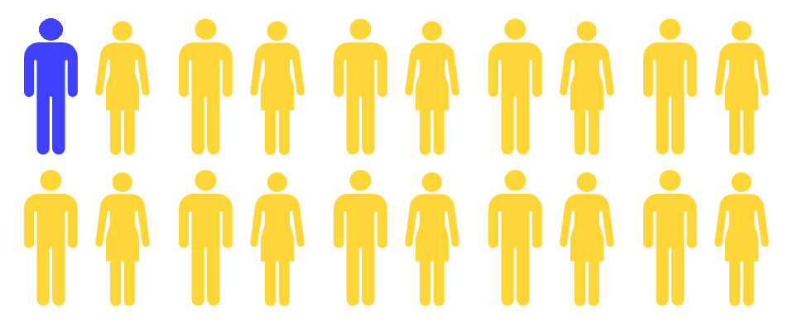


Adolescent Substance Use and Treatment
4.5% of adolescents ages 12-17
diagnosed with a past year SUD
Only 8.3% of them
received treatment
Source: Substance Abuse and Mental Health Services Administration. (2020). Key substance use and mental health indicators in the United States: Results from the 2019 National Survey on Drug Use and Health (HHS Publication No. PEP20-07-01-001, NSDUH Series H-55). Rockville, MD: Center for Behavioral Health Statistics and Quality, Substance Abuse and Mental Health Services Administration. Retrieved from https://www.samhsa.gov/data/
Notes:
Source: Substance Abuse and Mental Health Services Administration. (2020). Key substance use and mental health indicators in the United States: Results from the 2019 National Survey on Drug Use and Health (HHS Publication No. PEP20-07-01-001, NSDUH Series H-55). Rockville, MD: Center for Behavioral Health Statistics and Quality, Substance Abuse and Mental Health Services Administration. Retrieved from https://www.samhsa.gov/data/
During 2019 in the U.S:
4.5% of adolescents ages 12-17 were diagnosed with a past year SUD
8.3% of adolescents ages 12-17 were diagnosed with a past year SUD received treatment
0.7% of (all) adolescents ages 12-17 received any SUD treatment

Slide 43
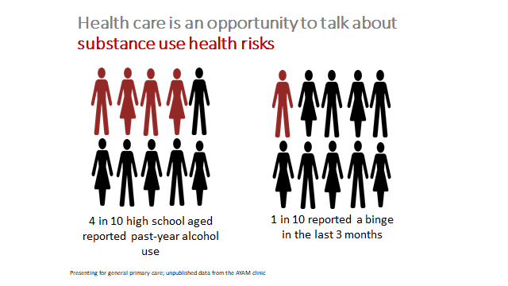
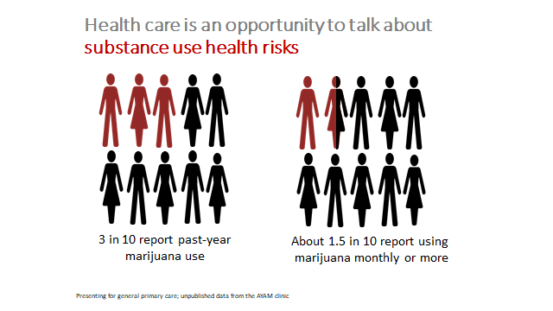
Evidence-Based Practices:
Early Intervention/Integrated Care
.

Slide 45
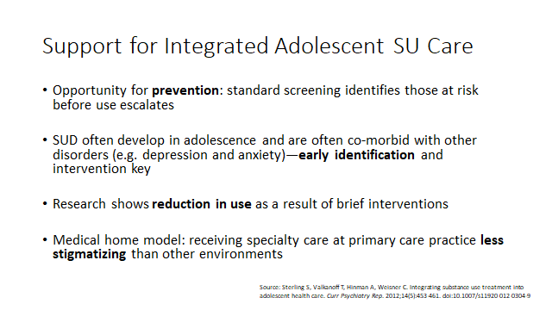

Slide 46
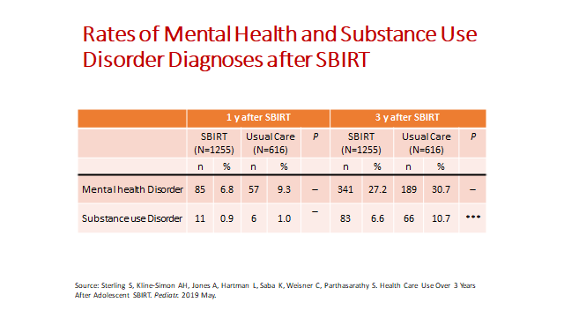
Notes:
Source: Sterling S, Kline-Simon AH, Jones A, Hartman L, Saba K, Weisner C, Parthasarathy S. Health Care Use Over 3 Years After Adolescent SBIRT. Pediatr. 2019 May.
RESULTS: Among a sample of eligible adolescents, the SBIRT group had fewer psychiatry visits at 1 year and 3 years. The SBIRT group was less likely to
have mental health diagnoses or chronic conditions at 1 year compared with those in usual care. At 3 years, the SBIRT group had fewer total outpatient visits and was less likely to have substance use diagnoses and more likely to have substance use treatment visits.

Slide 47

Novel Approaches to Integrated Care for Transitional Age Youth

Slide 48
Integration Efforts
Primary care SUD integration
Primary care telephonic consultation and virtual behavioral health treatment
School-based vaping groups
Juvenile justice partnership

Slide 49

Primary Care
Addiction
Medicine

Slide 50

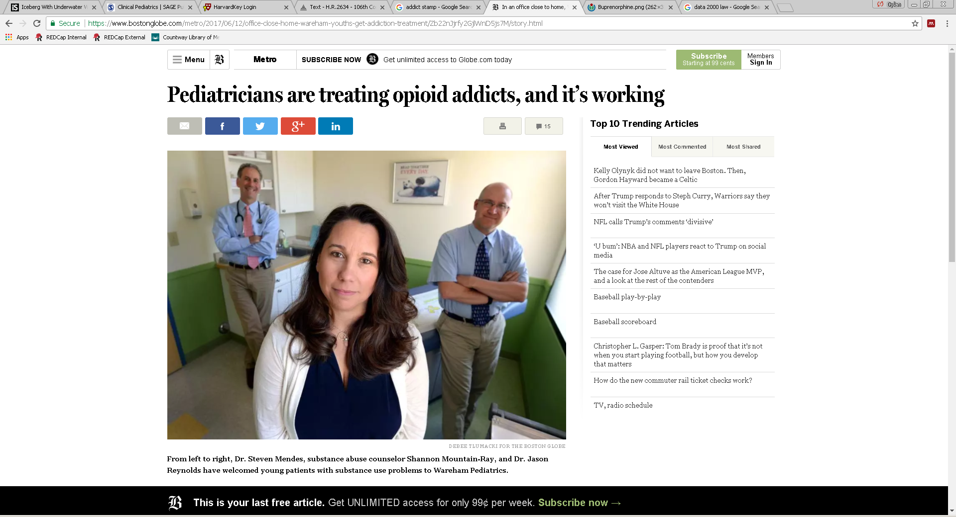
people who use opioids

Slide 51
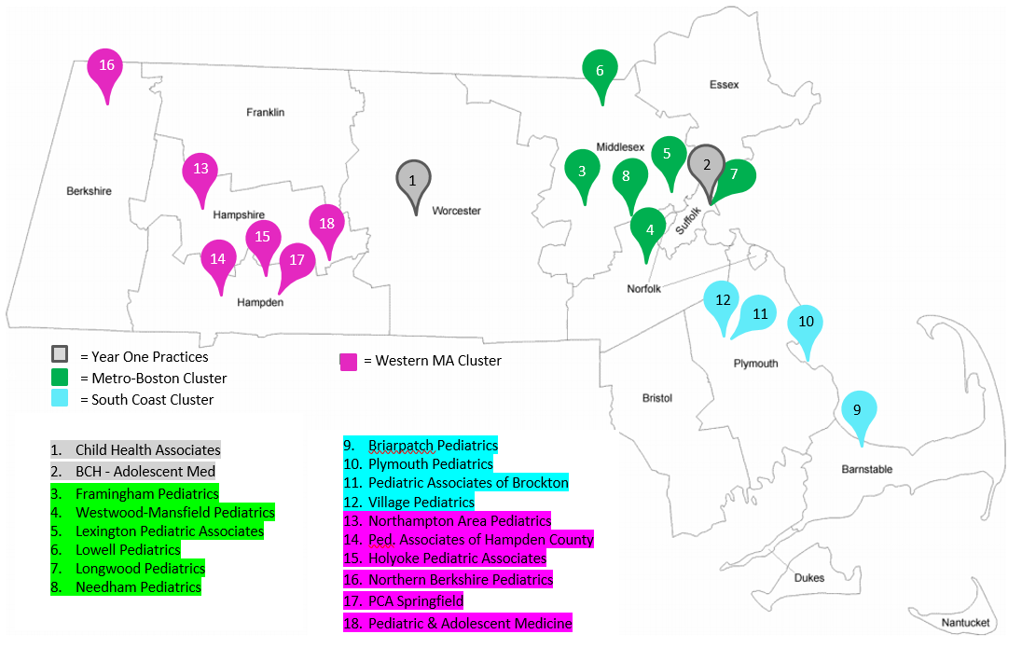
ASAP - Primary Care (ASAP-PC):
Fully-integrated clinical social worker in primary care setting as part of a multi-disciplinary team
Office-based
Outpatient treatment – “from experimentation to addiction”

Slide 52
Care Model
Focus on caring for patient in the medical home
Comprehensive Biopsychosocial Evaluation
Medications for Opioid, Alcohol, Cannabis and Nicotine Use Disorders
Psychosocial Treatment
Individual Counseling (MI, RP, CBT, etc)
Group Therapy (MI, RP, CBT, Psychoed)
Parent/Caregiver Guidance
Referral and Case Coordination

Slide 53


Support by Addiction Specialty Program

Slide 54
Screening Rates
 | Baseline | Q4 2019
 | 01Jan 2018-31Dec2018 | 01 Oct 2019 -31Dec2019
 | S2BI Completed | S2BI Completed
ASAP-PC Phase 1 | 17.6% | 63.1%
BRIARPATCH PEDIATRICS | 17.3% | 77.6%
CHILD HEALTH ASSOCIATES | 36.3% | 62.0%
FRAMINGHAM PEDIATRICS | 16.0% | 44.6%
NORTHAMPTON AREA PEDIATRICS | 1.3% | 64.0%
VILLAGE PEDIATRICS | 1.8% | 92.2%

Slide 55
Pilot (12 months)
Number of referrals: 60
Number of patients treated for Substance Use Disorder: 40
Number of teens with Opioid Use Disorder identified: 5
Number of inductions: 3

Slide 56
Results: Scale up to date
Number of sites recruited: 17
Number of patients screened: 6543
Number of patients seen by a social worker: 217
Notes:
Data as of 10/7/2020

Slide 57

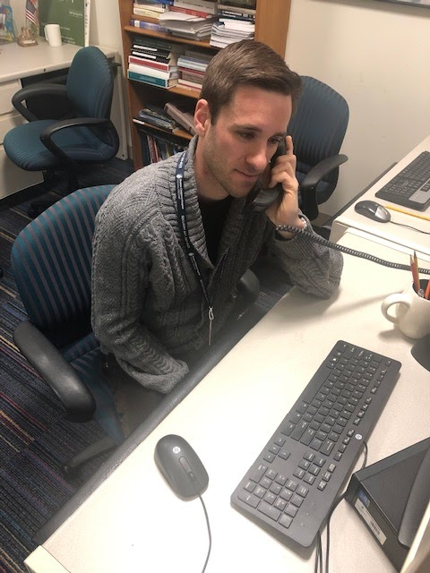
Telephonic Consultation

Slide 58
Telephonic Support for Youth SUD:
Call Volume
©Boston Children’s Hospital 2021. All Rights Reserved. For permission contact ASAP project manager at asap@childrens.harvard.edu.

Slide 59
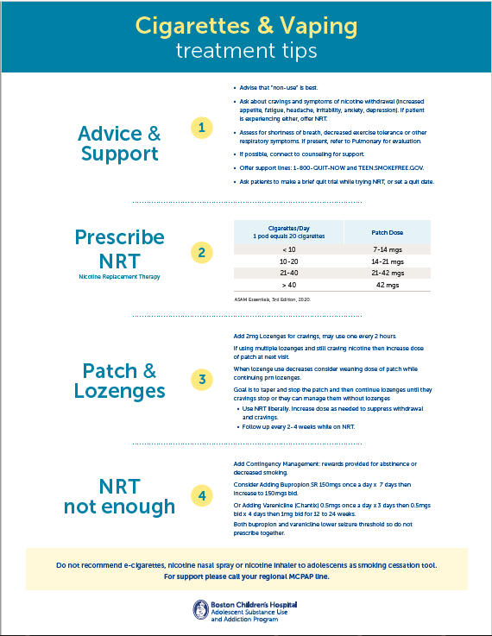

Slide 60
Table of Contents
1. | Screening & Brief Intervention: Updates and Guidance
2. | Brief Brief Interventions: Common Answers and Suggested Responses
3. | Nicotine: Managing Nicotine Use Disorders in Pediatrics
4. | Marijuana: Helping Kids Quit THC/Marijuana
5. | Alcohol: Managing Alcohol Use in Pediatric Primary Care
6. | Naltrexone for Opioid Use Disorder
7. | Buprenorphine Induction
8. | Drug Testing: Drug Testing in Pediatric Primary Care
9. | Coping with Cravings
10. | Behavioral Contracts
11. | Parent Guidance
12. | Co-occurring Mental Health Disorders
13. | Co-occurring Medical Disorders
14. | Referrals: Referrals to Higher Levels of Care
15. | Communication: Guidelines and Tips for Parents

Slide 61

Virtual Counseling

Slide 62

School Partnership
School-Based Virtual Vaping Group Therapy

Slide 63

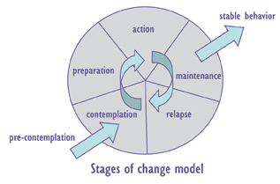
Group Structure
5 sessions
2 facilitators
MI, mutual aid, & psychoeducation
Notes:
4, 1-hour weekly zoom sessions
2 trained facilitators (BCH clinician and school counselor)
Motivational Interviewing (MI), mutual aid, and psychoeducation on the health effects of vaping nicotine
All stages of change welcome

Slide 64
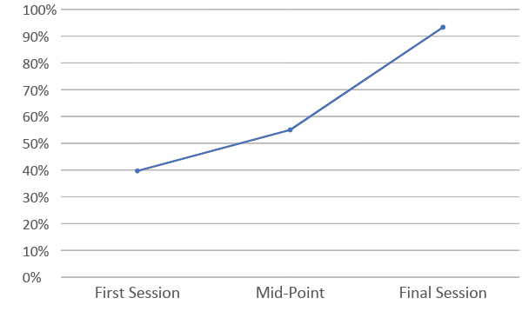
Proportion reporting past 7-day abstinence (N=15)

Slide 65

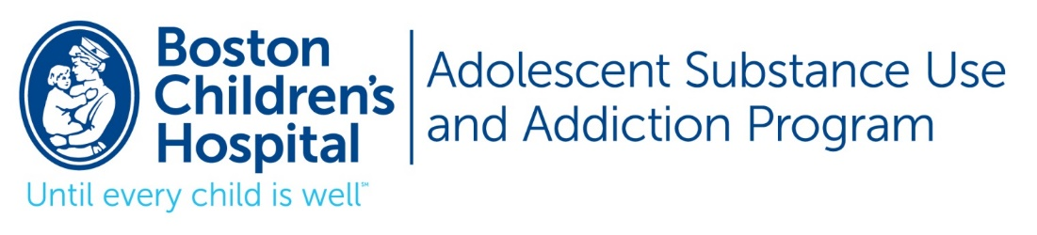
Juvenile Justice Partnership
GOAL: To improve the lives of youth involved in the juvenile justice system and reduce recidivism by treating substance use disorders

Slide 66
Services
  Addiction Medicine evaluation
  Medication Treatment as indicated
  Psychiatric assessment
  Medical advice and follow up
  Monitoring
  Individual counseling bridging from custody to community
  Parent collateral history and parent guidance

Slide 67
Evidence-Based Practices:
Outpatient Level of Care
.

Slide 68
Monitoring
The American Society for Addiction Medicine (ASAM) recommends random urine drug testing be used routinely in addiction treatment settings
  Should be non-punitive
  Should be used to enhance motivation and reinforce abstinence
  Should not be used as the sole determinant of treatment success
  Particularly important in outpatient treatment
  Particularly important in adolescents as they are less likely to report accurately
  The use of home drug tests should NOT be encouraged
Jarvis 2017; Baxter 2017
Notes:
Jarvis, M., Williams, J., Hurford, M., Lindsay, D., Lincoln, P., Giles, L., ... & Safarian, T. (2017). Appropriate use of drug testing in clinical addiction medicine. Journal of addiction medicine, 11(3), 163-173.
Baxter Sr, L., Brown, D. L., Hurford, D. M., Jacobs, W., Kleinschmidt, K., Kushner, M., ... & Williams, J. (2017). Appropriate use of drug testing in clinical addiction medicine. J Addict Med, 11, 1-56.

Slide 69
Pharmacologic Treatment
Improves patient survival
Increases retention in treatment
Decreases illicit opioid use and other criminal activity among people with substance use disorders
Increases patients’ ability to gain and maintain employment
Improves birth outcomes among women who have substance use disorders and are pregnant
SAMHSA 2020; Hadland 2018
Notes:
https://www.samhsa.gov/medication-assisted-treatment
Hadland, S. E., Bagley, S. M., Rodean, J., Silverstein, M., Levy, S., Larochelle, M. R., ... & Zima, B. T. (2018). Receipt of timely addiction treatment and association of early medication treatment with retention in care among youths with opioid use disorder. JAMA pediatrics, 172(11), 1029-1037.

Slide 70
Behavioral Treatment
Psychoeducation
Cognitive Behavioral Therapy
Motivational Interviewing/Motivational Enhancement Therapy
Contingency Management
Family-Based Modalities

Slide 71
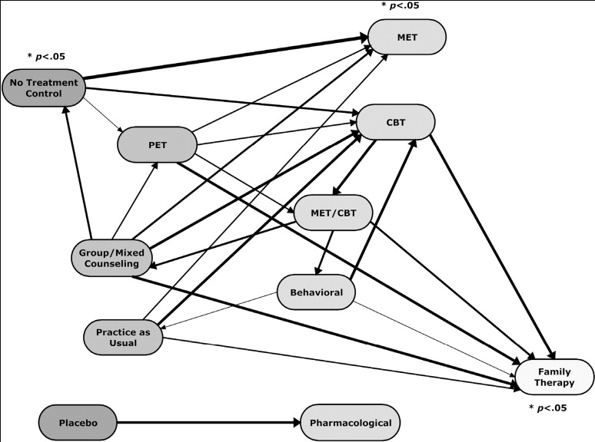

Behavioral Treatment
Tanner-Smith 2013
Notes:
A meta-analysis of outpatient treatment modalities by Tanner-Smith et al revealed that most treatment types are effective
PET – psychoeducational therapy
Notes: The arrows point to the treatment type with the more positive outcomes in each comparison. The thickness of each arrow indicates the magnitude of the mean effect size and the number of studies on which it is based, each equally weighted. The treatment types are arrayed from left to right with those to the right generally showing larger positive effects than those to the left with which they are compared.
Tanner-Smith, E. E., Wilson, S. J., & Lipsey, M. W. (2013). The comparative effectiveness of outpatient treatment for adolescent substance abuse: A meta-analysis. Journal of substance abuse treatment, 44(2), 145-158.

Slide 72
UCSF Youth Outpatient Substance Use Program (YoSUP)
A Multi-Disciplinary, family-based program for adolescents and young adults aged 12-25
Housed within the UCSF Adolescent & Young Adult Medicine Clinic

Slide 73
UCSF Youth Outpatient Substance Use Program (YoSUP)
Medical Services
Random weekly urine toxicology monitoring with expert interpretation
Naloxone prescription and education
Withdrawal management
Evidence-based pharmacologic treatment of substance use disorders (Buprenorphine, Naltrexone, etc)
Pharmacologic treatment of co-occurring psychiatric conditions
Risk reduction strategies/materials

Slide 74
UCSF Youth Outpatient Substance Use Program (YoSUP)
Psychosocial Services
Psychoeducation on addiction
Referrals for evidence-based family therapy
Parent guidance focused on safety and risk reduction
Behavioral contract development
Referrals to higher levels of care when appropriate
Facilitation of interagency collaboration and step-down services
Addiction psychiatry consultation

Slide 75
UCSF Youth Outpatient Substance Use Program (YoSUP)
Outcomes
November 2019 - December 31, 2020, 42 youth presented for intake at YoSUP.
Mean age 16.8 (SD = 2.2)
71% white, 15% Black/African American, 18% Asian, 15% Hispanic/Latinx, 6% Native Hawaiian/Pacific Islander, and 5% Native Hawaiian or Pacific Islander, and 12% American Indian or Alaskan Native
30 of 42 (71.4%) youth enrolled in treatment after intake
80% engaged in weekly urine drug screening
60% received medication for addiction treatment (MAT)
50% received individual or parent psychotherapy

Slide 76
UCSF Youth Outpatient Substance Use Program (YoSUP)
Outcomes
Substance Use Disorders
Cannabis use disorder - 76.5%
Alcohol use disorder - 29%
Opioid use disorder - 28%
Benzodiazepine or sedative/hypnotic use disorder in 26.5%
Co-Occurring Psychiatric Disorders
Co-occurring psychiatric disorders were present in 77.0% of youth, t
  Depression (47.1%), Anxiety (32.4%)
Approximately one-third of youth reported experiencing some form of emotional, physical, and/or sexual abuse over their lifetime

Slide 77
UCSF Youth Outpatient Substance Use Program (YoSUP)
Outcomes
Of the 42 youth who completed intake:
30 (71%) enrolled in treatment
  17 (57%) were still engaged in treatment (n=11) or had graduated from treatment (n=6) at the end of the data collection period
  13 (43%) terminated treatment early
13 youth completed a 6-month follow-up survey
Fewer youth reported using alcohol at follow-up (10-->3).
Fewer youth reported using cannabis at follow-up (10-->6)
Fewer youth reported alcohol and drugs simultaneously (4-->1)
Median number of days of cannabis used per month decreased from 9 to 0
Median number days of alcohol use per month decreased from 2 to 0
Fewer youth reported experiencing psychological or emotional problems at follow-up compared to intake
Notes:
The average duration of treatment engagement for youth who graduated was 6 months (range, 3-8 months

Slide 78

YSS
Since 1976 YSS has become one of the most respected youth-focused, nonprofit, social service organizations in Iowa.
Transforming lives throughout Central and North Central Iowa annually
  6,000+ individuals through programs
  10,000+ individuals through prevention/education services
For 40 years YSS has provided substance use treatment

Slide 79
YSS
From Infancy to Independence, YSS provides comprehensive services and believes in creating hope and opportunity by putting kids first.
Behavioral Health: Outpatient and Residential
Foster Care and Adoption Services
Shelter for homeless adolescents and TAY
Aftercare services for TAY aging out of foster care
Transitional Housing for TAY
Family Crisis Services
Human Trafficking Education
In-School and Community Based mentoring
Family Development and Self-Sufficient Services
Before School, After School and summer programming
Prevention education in schools
Integrated Health Services

Slide 80
YSS - SUD Outpatient and Intensive Outpatient
Treatment Services
Substance Use evaluations
OWI evaluations
Individual and group counseling for adolescents, TAY, and adults
Family therapy - MDFT
Trauma focused - EMDR and TF-CBT
Treatment Environments:
Clinics (6 locations)
  Adolescents, TAY and adults
Iowa State University
  Iowa State students and staff
Iowa Juvenile Training School
Adolescent males

Slide 81
Multi-Dimensional Family Therapy (MDFT)
Family based, comprehensive treatment model that targets the entire system that maintains substance use and other problematic behaviors
Focuses on four domains:
  Adolescent
  Parents
  Family
  Extra-Familial
Assesses and targets adolescent functioning in six health-related domains:
  substance use
  identity development and autonomy
  peers and peer influence
  bonding to prosocial institutions
  racial and cultural issues
  health and sexuality
Schmidt, S. (1996)
Liddle, H. (2009)
Notes:
Schmidt, S., Liddle, H., & Dakof, G. (1996). Changes in parenting practices and adolescent drug abuse during Multidimensional Family Therapy. Journal of Family Psychology,
Liddle, H., Rowe, C., Dakof, G., Henderson, C., & Greenbaum, P. (2009). Multidimensional Family Therapy for young adolescent substance abuse: Twelve-month outcomes of a randomized controlled trial. Journal of Consulting & Clinical Psychology,

Slide 82
Motivational Interviewing
Treatment approach that meets the individual where they are at and guides them toward change
It’s a communication style and approach rather than a set of techniques
Four aspects:
  Acceptance - absolute worth, accurate empathy, autonomy support, affirmation
  Partnership - “done for with with the person”
  Compassion - make the individual’s needs a priority
  Evocation - build on the individual's strengths and abilities
It allows autonomy, encourages collaboration and recognizes that the need for change exists within the individual
Recognizes that the individual’s motivation may fluctuate
Miller W.R., (2013)
Magill, M., (2017)
Colby S.M., (2018)
Notes:
Millers, W. R., Rollnick, S. (2013) . Motivational Interviewing: Helping People Change
Magill, M., Colby, S. M., Orchowski, L., Murphy, J. G., Hoadley, A., Brazil, L. A., & Barnett, N. P. (2017). How does brief motivational intervention change heavy drinking and harm among underage young adult drinkers?, Journal of Consulting and Clinical Psychology,
Colby, S. M., Orchowski, L., Magill, M., Murphy, J. G., Brazil, L. A., Apodaca, T. R., ... Barnett, N. P. (2018). Brief motivational intervention for underage young adult drinkers: Results from a randomized clinical trial. Alcoholism: Clinical and Experimental Research,

Slide 83
Evidence-Based Practices:
Residential Level of Care
.

Slide 84
YSS- SUD Residential
Since 1981, YSS has provided behavioral healthcare, becoming the first free-standing substance use residential treatment program for adolescents. Over 5000 adolescents have participated in residential treatment and over 100 in 2020.
For over 15 years YSS’ residential treatment programs have been gender responsive:
Seven 12 House - 8 bed female residence
Youth Recovery House - 15 bed male residence
North Iowa - 12 bed male residence (opened in 2018)
Interdisciplinary team provides therapy and education to address the addiction and develop insight and skills to maintain recovery, wellness, and prevent relapse.
Treatment program lasts 90-120 days
Family counseling can continue once discharged home
Recovery Supports continue throughout the transition home

Slide 85
YSS- SUD Residential
Family Involvement
YSS Residential Treatment programs value and highly encourage family involvement
  Provide monthly parent education groups
  Utilize MDFT while the adolescent is in treatment and continued once they return home in an outpatient setting
A-CHESS App
YSS Residential Treatment programs provide support after discharge
  Advocates work with the adolescents to create a transition plan, introducing them to the A-CHESS app
  Throughout the transition home, the Advocates stay in contact through the app
Notes:
Glass, Joseph E., McKay, James, R., Gustafson, David H., Kornfield, Rachel, Rathouz, Paul J., McTavish, Fiona M., Atwood, Amy K., Isham, Andrew, Quanbeck, Andrew, Shah, Dvanah (2017) Treatment seeking as a mechanism of change in a randomized controlled trial of a mobile health intervention to support recovery from alcohol use disorders Journal of Substance Abuse

Slide 86
YSS - SUD Residential
Gender Responsive Programming
Systems and treatment programs were historically designed for adult males
Patton & Morgan (2002) to “intentionally allow gender to affect and guide services so that the services match each girl’s needs. The services should create a context (through program environment and staffing) and provide content (through program approach and materials) that reflect an understanding of the realities of girl’s lives.”
Important to be Gender Responsive and Trauma Informed
Female Responsive, Trauma Informed Curriculum
  Women’s Way Through the Twelve Steps (Covington, S.)
  Voices - A Program of Self-Discovery and Empowerment FOR GIRLS (Covington, S., Covington K. and Covington, M.)
Male Responsive, Trauma Informed Curriculum
  Helping Men Recovery (Covington, S., Griffin, R., and Dauer, R.)
  The Council for Boys and Young Men (Hossfeld, B., Gibraltarik, R., Bowers, M., Taormina, G., Tyrol, K.)
Saxena, P. (2015)
Kubiak, S. (2013)
Notes:
Saxena, P., Grella, C. E., & Messina, N. P. (October 2015): Continuing Care and Trauma in Women Offenders’ Substance Use, Psychiatric Status, and Self-Efficacy Outcomes
Kubiak, S. (August 2013). Evaluation of Specialized Substance Abuse Treatment Services for Women: Report of Long-term Outcomes

Slide 87
Practical Issues in TAY Addiction Treatment
.

Slide 88
When youth refuse to engage in treatment

Slide 89

Community Reinforcement and Family Training (CRAFT)
Based on the Community Reinforcement Approach (CRA), which aims to help patients with SUDs to replace substance use with healthier behaviors through positive reinforcement
Meyers, 2011
Mindfood – Family Discussion posted in: Editorial, Illustration client: MindFood Magazine art direction: Grant Turner

Slide 90
Community Reinforcement and Family Training (CRAFT)
Engages families of treatment-resistant people with SUDs to use positive communication skills to transform the home environment in a way that reinforces behaviors associated with non-use of substances
  Reward behaviors that promote non-use
  Withhold reward when family member is using
Meyers, 2011

Slide 91
Community Reinforcement and Family Training (CRAFT)
Shown to promote engagement in treatment in up to 2/3 of treatment-resistant people
Enhances happiness of concerned significant others (i.e. family members)
Meyers, 2011

Slide 92
Community Reinforcement and Family Training (CRAFT)
Example:
  Mary, a 19 year old young woman with opioid use disorder (OUD) lives with her mother and is not interested in treatment for her OUD.
  The two women have a tradition of having Sunday breakfast together every week at 9:00am, which they both enjoy.
  When Mary uses opioids on weekends, she typically doesn’t come home or doesn’t wake up early enough for breakfast.

Slide 93
Community Reinforcement and Family Training (CRAFT)
Example:
  Previously, Mary’s mother would wait for Mary to come home on Sunday and cook a nice breakfast despite feeling frustrated about Mary’s late arrival.
  After CRAFT, Mary’s mother has a new strategy: If Mary isn’t home in time for 9:00am breakfast, she goes out for breakfast with a friend or goes to a yoga class.
    Mary is on her own for breakfast and Mary’s mother gets to do something that makes her happy!
Meyers, 2011

Slide 94
References
Dennis, M.; Babor, T.F.; Roebuck, C.; and Donaldson, J. Changing the focus: The case for recognizing and treating cannabis use disorders. Addiction 97:(s1):4–15, 2002.
McCabe, S.E.; West, B.T.; Morales, M.; Cranford, J.A.; and Boyd, C.J. Does early onset of non-medical use of prescription drugs predict subsequent prescription drug abuse and dependence? Results from a national study. Addiction 102(12):1920–1930, 2007.
Dennis, M., & Scott, C. K. (2007). Managing addiction as a chronic condition. Addiction Science & Clinical Practice, 4(1), 45.
Tanner-Smith, E. E., Wilson, S. J., & Lipsey, M. W. (2013). The comparative effectiveness of outpatient treatment for adolescent substance abuse: A meta-analysis. Journal of substance abuse treatment, 44(2), 145-158.: https://reader.elsevier.com/reader/sd/pii/S0740547212001055?token=ED01A398B7F9AAF267D482D923988F219AA4495CDBC5E3576197002FF07856064A26F91E20E82E5519E707ADDA579240
Mericle, A. A., Arria, A. M., Meyers, K., Cacciola, J., Winters, K. C., & Kirby, K. (2015). National trends in adolescent substance use disorders and treatment availability: 2003–2010. Journal of child & adolescent substance abuse, 24(5), 255-263.
Neinstein, L. S. (Ed.). (2016). Adolescent health care: a practical guide (Sixth Edition). Lippincott Williams & Wilkins.
Becan, J. E., Knight, D. K., Crawley, R. D., Joe, G. W., & Flynn, P. M. (2015). Effectiveness of the Treatment Readiness and Induction Program for increasing adolescent motivation for change. Journal of substance abuse treatment, 50, 38-49.
Titus, J. C., & Dennis, M. L. (2006). Cannabis youth treatment intervention: Preliminary findings and implications. Adolescent substance abuse: Research and clinical advances, 104-126.
Wu, L. T., Blazer, D. G., Li, T. K., & Woody, G. E. (2011). Treatment use and barriers among adolescents with prescription opioid use disorders. Addictive behaviors, 36(12), 1233-1239.
Campbell, C. I., Weisner, C., & Sterling, S. (2006). Adolescents entering chemical dependency treatment in private managed care: ethnic differences in treatment initiation and retention. Journal of Adolescent Health, 38(4), 343-350.

Slide 95
References
Jaycox, L. H., Ebener, P., Damesek, L., & Becker, K. (2004). Trauma exposure and retention in adolescent substance abuse treatment. Journal of Traumatic Stress: Official Publication of The International Society for Traumatic Stress Studies, 17(2), 113-121.
Battjes, R. J., Gordon, M. S., O'Grady, K. E., & Kinlock, T. W. (2004). Predicting retention of adolescents in substance abuse treatment. Addictive Behaviors, 29(5), 1021-1027.
Hadland, S. E., Bagley, S. M., Rodean, J., Silverstein, M., Levy, S., Larochelle, M. R., ... & Zima, B. T. (2018). Receipt of timely addiction treatment and association of early medication treatment with retention in care among youths with opioid use disorder. JAMA pediatrics, 172(11), 1029-1037.
Mee-Lee, D., Shulman, G. D., Fishman, M. J., Gastfriend, D. R., Miller, M. M., & Provence, S. M. (2013) The ASAM Criteria: Treatment Criteria for Addictive, Substance-Related, and Co-Occurring Conditions.
The ASAM Criteria, ASAM Continuum https://www.asamcontinuum.org/knowledgebase/what-are-the-asam-levels-of-care/.
Substance Abuse and Mental Health Services Administration. (2020). Key substance use and mental health indicators in the United States: Results from the 2019 National Survey on Drug Use and Health (HHS Publication No. PEP20-07-01-001, NSDUH Series H-55). Rockville, MD: Center for Behavioral Health Statistics and Quality, Substance Abuse and Mental Health Services Administration. Retrieved from https://www.samhsa.gov/data/.
Sterling, S., Valkanoff, T., Hinman, A. et al. Integrating Substance Use Treatment Into Adolescent Health Care. Curr Psychiatry Rep 14, 453–461 (2012). https://doi.org/10.1007/s11920-012-0304-9.
Sterling S, Kline-Simon AH, Jones A, Hartman L, Saba K, Weisner C, Parthasarathy S. Health Care Use Over 3 Years After Adolescent SBIRT. Pediatr. 2019 May.
Jarvis, M., Williams, J., Hurford, M., Lindsay, D., Lincoln, P., Giles, L., ... & Safarian, T. (2017). Appropriate use of drug testing in clinical addiction medicine. Journal of addiction medicine, 11(3), 163-173.

Slide 96
References
Baxter Sr, L., Brown, D. L., Hurford, D. M., Jacobs, W., Kleinschmidt, K., Kushner, M., ... & Williams, J. (2017). Appropriate use of drug testing in clinical addiction medicine. J Addict Med, 11, 1-56.
Schmidt, S., Liddle, H., & Dakof, G. (1996). Changes in parenting practices and adolescent drug abuse during Multidimensional Family Therapy. Journal of Family Psychology.
Liddle, H., Rowe, C., Dakof, G., Henderson, C., & Greenbaum, P. (2009). Multidimensional Family Therapy for young adolescent substance abuse: Twelve-month outcomes of a randomized controlled trial. Journal of Consulting & Clinical Psychology.
Millers, W. R., Rollnick, S. (2013) . Motivational Interviewing: Helping People Change.
Magill, M., Colby, S. M., Orchowski, L., Murphy, J. G., Hoadley, A., Brazil, L. A., & Barnett, N. P. (2017). How does brief motivational intervention change heavy drinking and harm among underage young adult drinkers?, Journal of Consulting and Clinical Psychology.
Colby, S. M., Orchowski, L., Magill, M., Murphy, J. G., Brazil, L. A., Apodaca, T. R., ... Barnett, N. P. (2018). Brief motivational intervention for underage young adult drinkers: Results from a randomized clinical trial. Alcoholism: Clinical and Experimental Research.
Glass, Joseph E., McKay, James, R., Gustafson, David H., Kornfield, Rachel, Rathouz, Paul J., McTavish, Fiona M., Atwood, Amy K., Isham, Andrew, Quanbeck, Andrew, Shah, Dvanah (2017) Treatment seeking as a mechanism of change in a randomized controlled trial of a mobile health intervention to support recovery from alcohol use disorders Journal of Substance Abuse.
Saxena, P., Grella, C. E., & Messina, N. P. (October 2015): Continuing Care and Trauma in Women Offenders’ Substance Use, Psychiatric Status, and Self-Efficacy Outcomes.
Kubiak, S. (August 2013). Evaluation of Specialized Substance Abuse Treatment Services for Women: Report of Long-term Outcomes.

Slide 97
Thank You!
Veronika Mesheriakova, MD
Assistant Professor of Pediatrics and Adolescent Medicine, UCSF; Director of UCSF Youth Outpatient Substance Use Program (YoSUP)
Shannon Mountain-Ray, MSW, LICSW
Director of Integrated Care, Adolescent Substance Use and Addiction Program’s Primary Care Program (ASAP-PC), Boston Children’s Hospital
Andrea Dickerson, LMFT, IADC
Director of Behavioral Health – YSS
Notes:
Thank you for today’s presentation Shannon, Veronika and Andrea

Slide 98

Related Products & Resources
from the ATTC Network
CLAS Standards in Behavioral Health: Working with Youth and Adolescents (Recorded webinar)
Understanding Latino Youth Recovery: Issues, Assets and Creating Resiliency (Recorded webinar)
Adolescent Brain Maturation and Health: Intersections on the Developmental Highway
  Recorded presentation
  Handouts
Effects on Marijuana Use on Developing Adolescents (Recorded webinar)
Vaping Overview and CATCH My Breath Program (Recorded webinar)
Vaping 2: Education vs Punishment Using Deferred Citation (Recorded webinar)
Understanding Suicide Part 2 Adolescents and the Changing Brain (Recorded webinar)
attcnetwork.org/centers/global-attc/tay-webinar-series
Notes:
To augment the information provided today, you can explore these additional resources from the ATTC and PTTC Networks.

Slide 99

Related Products & Resources
from the PTTC Network
Underage Alcohol Use: An Overview of Data and Strategies (Recorded webinar)
Youth Opioid Addiction: What Preventionists Need to Know (Recorded webinar)
Selecting and Implementing Evidence-Based Practices to Address Substance Misuse Among Young Adults: Webinar on SAMHSA’s Resource Guide
Preventing Youth Vaping (Webinar Series) Part 1 of 2: The Extent and Risk Factors for Youth Vaping (Recorded webinar)
Preventing Youth Vaping Part 2 of 2: Policy Recommendations and Promising Practices for Addressing Youth Vaping (Recorded webinar)
The Benefits of Engaging Youth in Communities: Insights and Evidence from Developmental Science (Recorded webinar)
Vaping and LGBTQ Youth (Recorded webinar)
Informing Prevention 6-Part Webinar Series on Adolescents: Mountain Plains PTTC
Adolescent SBIRT Pocket Card
attcnetwork.org/centers/global-attc/tay-webinar-series

Slide 100



Keep in Touch with
the AMERSA Network
For more information about AMERSA visit: www.amersa.org
Join our mailing list: https://amersa.org/contact-us/
@AMERSA_tweets
@AMERSA2021
amersa.org/resources/tay-webinar-series/
Notes:
You can also keep in touch with ATTC, NORC and AMERSA via their newsletters and social media. Sign up to receive emails and follow them on Twitter and Facebook.

Slide 101
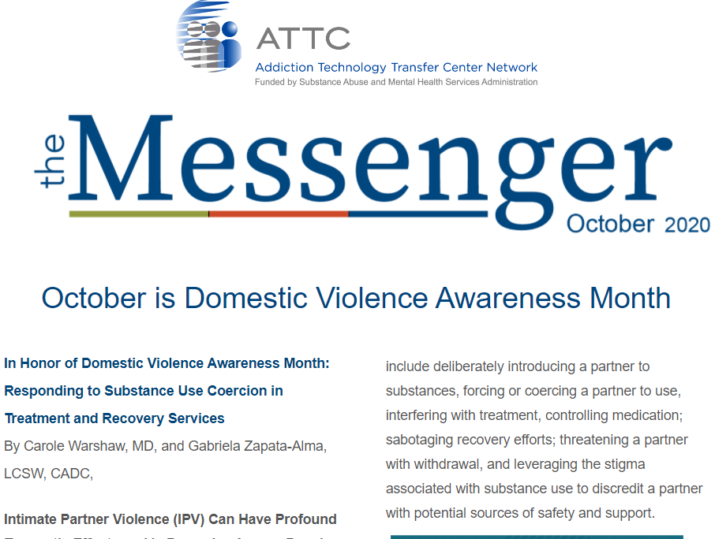
Keep in Touch with
the ATTC Network
ATTC Network Office publishes the Messenger monthly
  Subscribe: https://attcnetwork.org/centers/global-attc/subscribe-attc-messenger
@ATTCnetwork
@attcNetwork
attcnetwork.org/centers/global-attc/tay-webinar-series

Slide 102
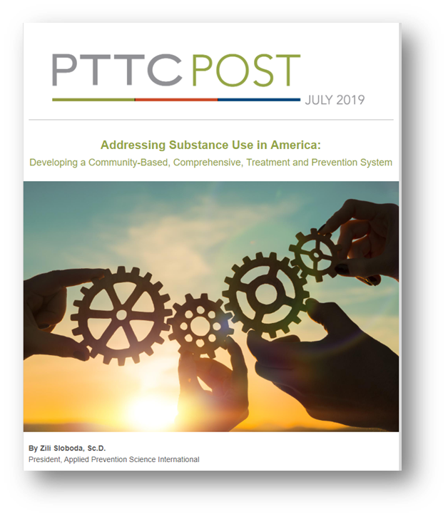
Keep In Touch with
the PTTC Network
PTTC Network Office publishes the PTTC POST monthly
  Subscribe:
  https://pttcnetwork.org/centers/global-pttc/pttc-subscription-page
@PTTCnetwork
@PreventionTTCnetwork
attcnetwork.org/centers/global-attc/tay-webinar-series

Slide 103
Who? What? Where? Why?
Clinical Sites for TAY Addiction Treatment
Produced in Partnership by:
amersa.org/resources/tay-webinar-series/
Notes:
Thank you so much for attending. That concludes today’s webinar.

